Slide 1
Inclusive Housing Practices Regarding Sexual Orientation and Gender Identity
Jess McCafferty
LGBT Equality Fellow
ACLU of Idaho Foundation

Slide 2
As we start…
What is your sex?
What is your gender?
What is your sexual orientation?
What is your gender identity?
Are you confident you knew what each question was asking?

Slide 3
Defining Terms- Sex and Gender
Sex: the biological and physiological characteristics that define female and male
Male and Female
Ex: testes and ovaries, bone structure
Gender: the social constructed roles, behaviors, activities and attributes that a given society considers appropriate for women and men
Masculine and Feminine
Ex: Saudi Arabia- women aren’t allowed to drive, US- women earn less money than men.
Notes:
There are lots of words on these next couple slides- I won’t be giving you a test after, so no worries about memorizing all these definitions. I wanted to give you several ways to take in this information in and digest it. These terms are really important to understand in order to follow along with what LGBT means. Sex refers to biology and physiology. Sex is physical and

Slide 4
Defining Terms- Sexual Orientation and Gender Identity
Sexual Orientation: An individual’s emotional, physical and romantic attraction to another individual.
Gender Identity: An individual’s emotional and psychological sense of being a man or a woman
Gender Expression: An individual’s outward expression of masculinity and femininity
Biological Sex: An individual’s biological and physiological characteristics that define female and male
Notes:
What gets confusing for some is that gender identity and sexual orientation are two different spectrums.
We will look at various kinds of sexual orientation, then move on to gender identity a little later.

Slide 5
Sexual Orientation- Heterosexual
Notes:
One person of one biological sex who is emotionally, physically and romantically attracted to someone of the opposite biological sex
In this case, Faith Hill, the woman in this picture, is a female, expressing feminine characteristics. She also identifies as a woman.
Time McGraw, identifies as a man, and is expressing masculine characteristics.
Since they are married, it’s mostly safe to say that there is some form of attraction between the two of them, making them a heterosexual couple
This seems easy enough right? This is the sexual orientation that is the most common in our society. You all know someone (if not yourself) that has a heterosexual sexual orientation.
Biological Sex: An individual’s biological and physiological characteristics that define female and male
Sexual Orientation: An individual’s emotional, physical and romantic attraction to another individual.
Gender Identity: An individual’s emotional and psychological sense of being a man or a woman
Gender Expression: An individual’s outward expression of masculinity and femininity

Slide 6
Sexual Orientation- Lesbian
Notes:
This picture is illustrating another sexual orientation- homosexuality. Homosexuality is when someone identifies as one sex and also is attracted (emotionally, romantically and/or phsyically) to the same sex. This picture is showing two women, which can sometimes be referred to as lesbians in a homosexual relationship.
In this case, Ellen DeGeneres, the woman in this picture with the collared shirt, is a female, expressing feminine characteristics. She also identifies as a woman.
The women in the picture wearing a dress, Portia de Rossi, identifies as a woman, and is expressing feminine characteristics.
I know they are lesbians because they have publically expressed their identities. Ellen “came out” in the 90’s and Portia and her have had a wedding. I wouldn’t know that either of them identified as lesbians without them saying it- even though Ellen doesn’t choose to wear feminine clothes or wear her hair long. As much of us know, being a woman is not cut and dry, and neither is sexual orientation.
The term homosexuality in our society has been used for some time- I think you all know what I mean when I say lesbian or gay.

Slide 7
Sexual Orientation- Gay
Notes:
This picture is also illustrating a homosexual sexual orientation- since these two people are men, they are considered gay- the male version of homosexuality. Jesse Tyler Ferguson married Justin Mikita, which is again how someone can assume they are men who are attracted to other men. They both are expressing masculine characteristics, they both have expressed that they are gay men.
When we look at homosexual relationships, sometimes it is hard to understand the attraction to one another when we are attracted to someone of the opposite sex. There are multitudes of ways that the social construction of gender roles and what we assume about homosexual relationships collide and don’t necessarily make sense. If we think about sexual orientation as attraction, it gets a bit easier. When someone who has a homosexual sexual orientation thinks of the person they want to spend their bad days with, it happens to be someone of the same sex. When someone who is has a homosexual sexual orientation thinks of a person that they would want to swoon or impress, they think of a person of the same sex. It rarely has anything to do with trying to find a “husband” or “wife” of the same sex to fit the role the person of the opposite sex.

Slide 8
Sexual Orientation- Bisexual
Notes:
Bisexuality describes someone who is attracted to both men and women. They can have homosexual relationships and heterosexual relationships in their life time. People who identify as bisexual are not confused at who they are attracted to- they are attracted to a variety of sexes. A lesbian may have had relationships with men in the past, but now exclusively date women. Gay men may also have had similar experiences. Bisexuality refers to actively being attracted to both sexes.

Slide 9
Gender Identity- Cis gender
Notes:
Cis-gender is not as scary or foreign as it sounds. Most of you in the audience are cis-gender. All it means is that your gender identity is the same as the sex you were assigned at birth. You are cis-gender if you were born with a vagina, a uterus, breasts, and also think of yourself as a woman.
Again, this is the easy one. Most of us are comfortable with this because we ourselves are cis-gender.

Slide 10
Gender Identity- Transgender
Notes:
Trans*gender is when it gets difficult. Someone is transgender when they identify as a different gender than their sex at birth. The woman in the picture is Laverne Cox. She was born a boy, but has lived most of her life as a woman. The man in the photo is the opposite. He was born a girl, but identifies as a man, and lives his lie as such.
Transgender individuals do a variety of things to “transition” once they realize they are transgender. Everyone is different. Some people take hormones to alter their physical appearance and internal body. Others have surgeries to alter their bodies to match who they feel they are.
People have a harder time understanding people who are transgender. It’s a confusing concept because most of us have never felt like our body hasn’t matched with our inner sense of self. They aren’t confused. People like Laverne Cox and Chaz Bono have done lots of self reflection and know that their gender now is who they are. We will talk more about transgenderism a little later.

Slide 11
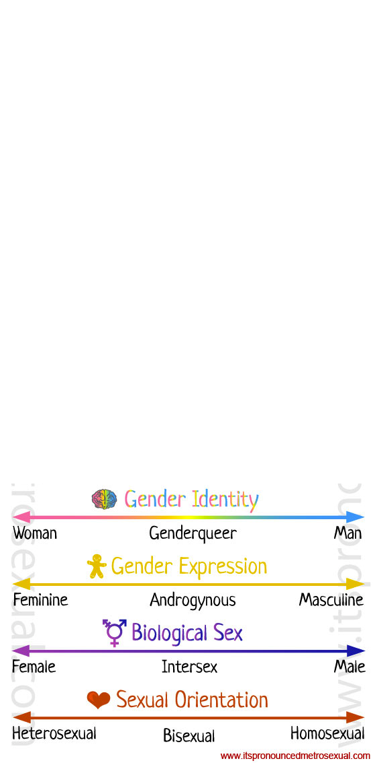
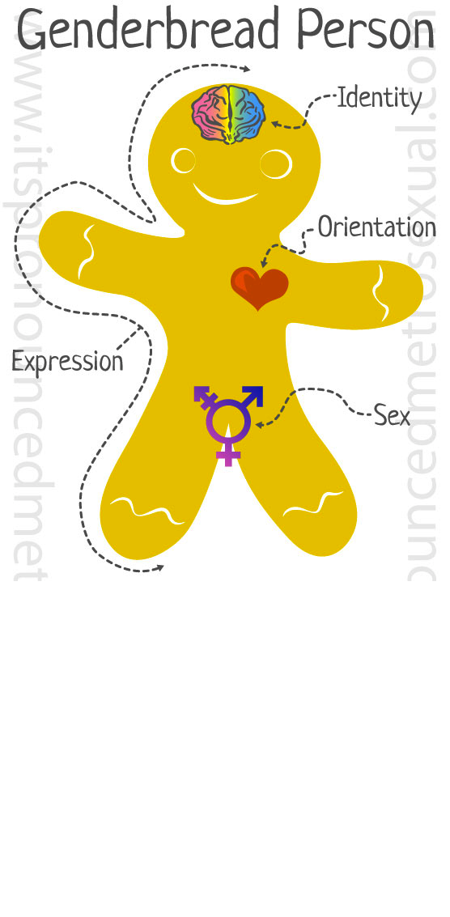

Slide 12
Housing Laws- Federal
No Official Protections
Fair Housing Act
HIV/AIDS
Gender Stereotyping
Sexual Orientation in FHA insured loan
Notes:
The Fair Housing Act is similar to the EEOC rulings in that if a person is discriminated against because of their sexual orientation and/or gender identity, they MAY be covered, though it isn’t explicitly stated
A gay man is evicted because his landlord believes he will infect other tenants with HIV/AIDS. That situation may constitute illegal disability discrimination under the Fair Housing Act because the man is perceived to have a disability, HIV/AIDS.
A property manager refuses to rent an apartment to a prospective tenant who is transgender. If the housing denial is because of the prospective tenant's non-conformity with gender stereotypes, it may constitute illegal discrimination on the basis of sex under the Fair Housing Act.
An underwriter for an FHA insured loan is reviewing an application where two male incomes are being used as the basis for the applicants’ credit worthiness. The underwriter assumes the applicants are a gay couple and, as a result, denies the application despite the applicants’ glowing credentials. This scenario may violate HUD regulations which prohibit FHA-insured lenders from taking actual or perceived sexual orientation into consideration in determining adequacy of an applicant’s income.

Slide 13
Housing and Urban Development
Prior to 2011
Proposed rule
Sexual Orientation: Homosexuality, Heterosexuality, Bisexuality.
Gender Identity Actual or perceived gender related characteristics
HUD
Equal Access
Definitions
Inquiries
FHA insured loans
Notes:
There were many studies about the treatment of LGBT people in the housing market prior to 2011, most to all of the reports found that LGBT people faced discrimination based on their sexual orientation and/or gender identity in housing. From that research and those reports, HUD proposed a rule in January of 2011 that advised that LGBT people did not have equal access to housing. From June to Oct of that year, HUD conducted an in depth study was conducted to see how pervasive the problems were, and what steps needed to be taken in order to ensure equal opportunities for housing for LGBT people. The report found that same sex couples experience less favorable treatment with inquiries via email than those in apparent opposite sex relationships.
Based on the research from HUD as well as other studies, the proposed rule was adopted in March of 2012.
The definitions of sexual orientation and gender identity are as follows:
Sexual Orientation: Homosexuality, Heterosexuality, Bisexuality
Gender Identity: Actual or perceived gender related characteristics
Any housing authority that receives HUD funding is specifically prohibited from discriminating on the basis of sexual orientation and gender identity.
HUD’s specific rules, which came into effect in March of 2012, include four major pillars
The first is related to equal access to all HUD programs. This includes public housing, section 8, FHA insured loans, CDBG. This is general, and was placed in the rules as such to have a general equal access clause after the public comment period.
The second, relating to definitions, is specific to “family” and “household” and making sure those definitions are inclusive of the LGBT community. Explicitly stating that family and household are terms separate from sexual orientation, gender identity and marital status is very important to staying legal now that this law is in place. “a group of persons living together”
The third, relating to inquiries, is simple. You cannot inquire about someone’s sexual orientation or gender identity.

Slide 14
Housing Laws- State
Notes:
these are legislative, statewide policies, not court case presidents or voter decisions
The dark green states are states with statewide protections against discrimination in housing on the basis of sexual orientation and gender identity
The light green states only offer statewide protections against discrimination in housing on the basis of sexual orientation
There are 17 states and DC that have protections for LGBT people’s employment.
An additional 4 states protect employment on the basis of sexual orientation alone

Slide 15
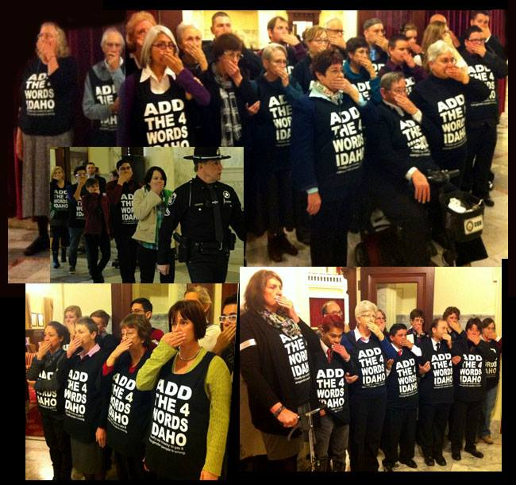
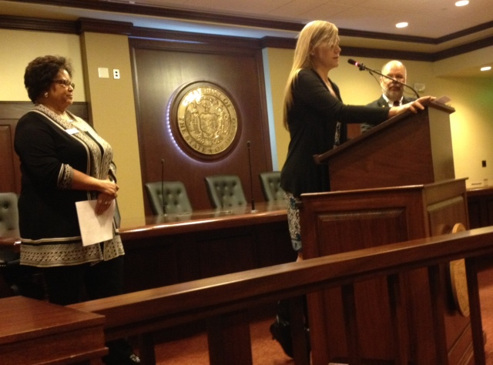
Statewide Policies
Amending the
Idaho Human Rights Act
Notes:
A group of people have been trying to amend our state’s human rights act for 8 years to include explicit protections for sexual orientation and gender identity.
Their tactics have varied widely in the past 8 years from scheduling meetings with legislators, holding educational events, placing sticky notes on legislator’s doors, to most recently civil disobedience.
Our legislature has heard from the LGBT population on similar topics, including same-sex marriage regulations
cities looked at passing nondiscrimination ordinances in the absence of state wide protections

Slide 16
Employment, Housing and Public Accommodations Laws- Local
States with NDOs
Arizona
Florida
Georgia
Idaho
Indiana
Kansas
Kentucky
Louisiana
Maryland*
Michigan
Missouri
Montana
Nebraska
New York*
N. Dakota
Ohio
Pennsylvania
S. Carolina
Texas
Utah
Virginia
West Virginia
Wisconsin*
States without NDOs
Alabama
Alaska
Arkansas
Mississippi
New Hampshire*
N. Carolina
Oklahoma
S. Dakota
Tennessee
Wyoming
Notes:
In addition to the states with statewide nondiscrimination protections, there are over 200 cities and counties across the country that have adopted these protections in the absence of statewide laws. Each of the 23 states in blue has at least one city with a nondiscrimination ordinance, while the 10 states in the brown color still are widely unprotected. These decisions are made my local governing bodies, and have also been voted on by residents, either as an initiative ballot measure, or a repeal ballot measure.
The states with asterisks are states with statewide sexual orientation protections, so the ordinances at the municipal level protect against gender identity discrimination.
We see Idaho on there- does anyone know how many cities have nondiscrimination laws?

Slide 17
Nondiscrimination Ordinances
Notes:
the answer is 7!

Slide 18
Boise’s Nondiscrimination Ordinance
Section 6-02-03 PROHIBITED DISCRIMINATORY ACTS
The following acts are prohibited and shall constitute a misdemeanor:
C. To deny to or discriminate against any other person because of sexual orientation and/or gender identity/expression in the sale, purchase, lease or rental of any housing accommodation, or to otherwise discriminate in the terms and conditions, maintenance, improvement or repair of any housing accommodation.

Slide 19
Boise’s Nondiscrimination Ordinance
Section 6-02-04 EXCEPTIONS
C. This ordinance shall not apply:
(a) to the rental of a housing accommodation in a building which contains housing accommodations for not more than two (2) families living independently of each other, if the lessor or a member of his family resides in one (1) of the housing accommodations, or
(b) to the rental of a room or rooms in a single family residential housing accommodation by an individual if he or a member of his family resides therein.

Slide 20
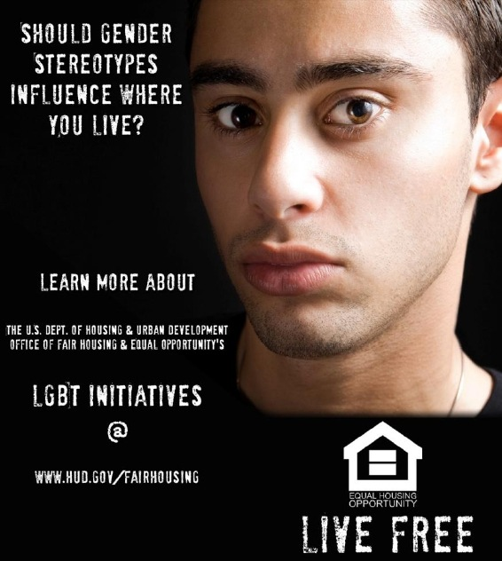
Are You Being Inclusive?
Notes:
HUDhas launched a new media campaign, “Live Free,”that will, among other things, strive to ensure that people have equal access to housing regardless of sexual orientation and gender identity.
The Fair Housing Act prohibits housing discriminate based on race, color, national origin, religion, sex, disability, or families with children. While sexual orientation and gender identity are not prohibited bases of discrimination under the federal Fair Housing Act, housing discrimination against someone who is LGBT may, in certain circumstances, violate the Act’s existing provisions, including its prohibition against gender discrimination.
“While 20 states and over 200 local governments have led the way to make LGBT-related housing discrimination illegal, HUD is firmly committed to supporting the right of LGBT individuals and families to lead productive and dignified lives, free from housing discrimination and fear of retaliation, said John Trasviña, HUD Assistant Secretary for Fair Housing and Equal Opportunity. “HUD is finalizing a federal rule to ensure that HUD housing and programs are open to all, irrespective of marital status, gender identify, and sexual orientation.”
The “Live Free” print advertisements are focused to particular targeted audiences. For example, one print ad reads “Should Gender Stereotypes Influence Where Your live? Learn More.” “Live Free” campaign will run throughout the year and include Facebook ads, targeted print ads, digital videos, and podcasts.
In 2010, HUD provided Guidance to its staff on how to more effectively address inquiries from LGBT individuals regarding housing discrimination issues and also launched a webpage for the public on LGBT housing discrimination. Since then, HUD’s housing discrimination complaint level from LGBT individuals has increased significantly. From July 1, 2010 to February 28, 2011, LGBT individuals filed 47 complaints of housing discrimination alleging gender discrimination with HUD. During the same period straddling 2009 and 2010 prior to issuance of the guidance, HUD only received 3 such complaints.
Read more here: http://miamiherald.typepad.com/gaysouthflorida/2011/04/hud-fair-housing-act-campaign-focuses-on-access-for-lesbian-gay-bisexual-transgender-people.html#storylink=cpy

